Slide 1
Python REST implementation of Organization Personnel Managing
Efim Zabarsky

Slide 2
Requirements
Overlay interpretation
Representing overlay frames (in feature version filtered frames too)
Supporting online for online

Slide 3
OverlayFrameGroup Entity
Due to inability to detach (remove) existing FrameGroup class it will be left intact in the current release.
OverlayFrameGroup class will be created and used beside of FrameGroup.
OverlayFrameGroup will be used in very similar manner to FrameGroup (both implement IFrameGroup interface)
OverlayFrameGroup Footprint calculation logics is redundant, every usage will be removed.
OverlayFrameGroup treatment in online mechanism (Overlay updated)

Slide 4
Frames treatment
At Nato version interpretation got Frames from FrameGroup entities. In the newer version, Frames will be provided on demand.
IOverlayFramesProvider service will notify the subscribers about arrived and existing frames.

Slide 5

Architecture

Slide 6
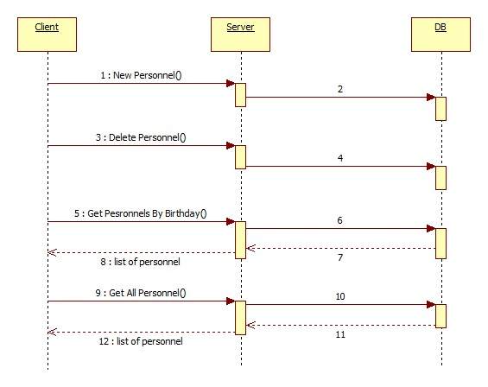
Organization Personnel Managing
Sequence Diagram
Notes:
6

Slide 7
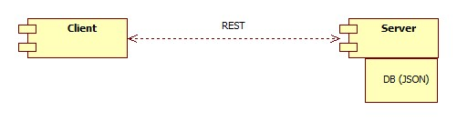
Organization Personnel Managing Component diagram
Notes:
7

